Slide 1

Rewards & Progress
Log Analysis with Random Forest
& AWS Deep Racer
Capstone 2, Supervised Learning
Steven Salmons

Slide 2
Overview
Preface Rules of the road; Environment + Data Set
What Better Features = Better Rewards
Why Random Forest
How Use Case, Applied Results
Who Target Audience
Caution Flag!

Slide 3

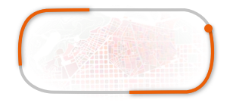


The Environment
AWS Deep Racer
F1-inspired, physical and virtual
Reinforcement learning
Reward Fn & Randomness

Slide 4
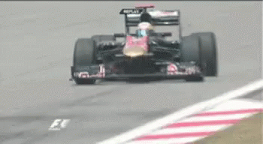

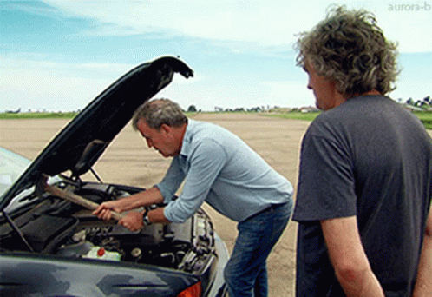
The Context
Go Race
Gain new experience
Log Analysis
Telemetry
Discover trends
Evaluate performance
Deep Racer Lifecycle
Make Adjustments
Reward Function Hyperparameter tuning

Slide 5
What are we looking to prove?
Higher Reward
Applied Consistently (Reward Fn)
Tested Randomly (RL)
Better Feature Selection

Slide 6
Why Random Forest
Why Not…
The Basics
Decision Tree
Naive Bayes
Support Vector
Gradient Boosting
XGBoost
Regression
Linear/Logistic
KNeighbors
Decision Trees
Feat. Selection
Robust
Less prone to overfitting *
Less impact from bad data quality
Missing, outliers…
Quantify feature importance *
Can handle highly dimensional data
Handles diverse data, does not need to be normalized or linear *
Scales to support large datasets *
Time to market *

Slide 7



Use Case: Race Results
Feature Set | Reward (est.) | Lap Time (est.)
Average | 100 pts | 2m 30s
Better | 250 pts | 1m 45s
Best | 750 pts | 50s

Slide 8
Target Audience
Contributors
Managers/Directors
Gaps in Logic
Features + Fn = StabLe?
Higher degree of confidence
Higher impact
Faster iterations, performance
Improve lap times
Complete harder tracks
Resource & Data
Retention
Cost $ -> $$ -> $$$
Return on Investment
Aligned focus
Less distraction
Efficiency

Slide 9



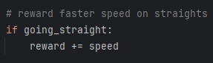
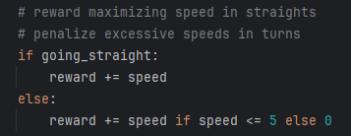
Caution: Pump The Breaks!
Features are one part of a much larger development effort.

Slide 10
The Rear View
Racecar = Sum of its parts
Approach : Features
Raceline v. Centerline
Line v. Progress
Random Forest = Sum of its trees
Approach : : Features
Maintain awareness, on/off track
Not performing as expected? Check engine!
Questions & Comments
Go Race!

